Slide 1
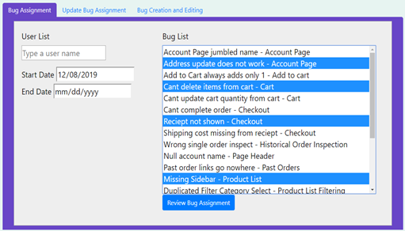
Bugs are Features Too, Two
Customer: Trissential - Software QA
Goal: Creature a mock e-commerce website with the ability to assign bugs that appear for users when interacting with the store
Purpose: To provide our customer with a platform which they can use to train and evaluate Software QA skills, by training programmers to look and test for bugs.

